Slide 1


Ph.D. Defense
April 20th, 2017
Link layer Designs for Short-range Wireless Access Spanning ISM to mmWave Bands
Ram Subramanian
Ph.D. Candidate
Northeastern University, Boston
Dissertation Committee Members:
Prof. Kaushik Chowdhury (Advisor)
Prof. Miriam Leeser
Prof. Stefano Basagni
Next GEneration NEtworks and SYStems Lab

Slide 2
MAJOR CONTRIBUTIONS
2
MATLAB-based IEEE 802.11b Compliant Link Layer
Finite State Machine (FSM) based design
Full parameter flexibility
Design and Code publicly available
SDN Controlled Switching Design for mmWave and THz Small Cells
Analytically modeled the capacity of the small cell network
Resource Allocation Scheme for mmWave V2I Network
Resource allocation scheme for efficient multi-user scheduling
Designed a directional MAC protocol that encompasses a new user association phase
Designed a polynomial-time algorithm for scheduling multiple vehicles
Massive Vehicle-to-Infrastructure (V2I) data transfers around 100 Terabit is possible with a single journey → Potential for inter-data center backhauling of delay insensitive data
Notes:
Model based design drove code development -> PHY and MAC layer. Underwater sensor networks.

Slide 3
NOVELTY OF THE CONTRIBUTIONS
3
MATLAB-based IEEE 802.11b Compliant Link Layer
SDN Controlled Switching Design for mmWave and THz Small Cells
First work to present an analytic description of the capacity resulting from preferentially switching between mmWave and THz bands
Actual road maps and data center locations within Boston used for performance evaluation
Resource Allocation Scheme for mmWave V2I Network
First work to design the radio frame structure using coherence bandwidth and coherence time specific to mmWave V2I communication.
Resource allocation scheme developed for first time in multi-vehicle scenario
First work to take a software-only approach and to report 802.11 MAC layer results from over-the-air experimentation on USRP radios
Code developed entirely in MATLAB
Designed a novel MAC protocol for vehicles equipped with transceivers capable of dynamic spectrum switching to achieve massive data transfers
No MATLAB-based design/code available
Notes:
1. What makes our work unique?
Testbed to experiment with and enables creation of new MAC protocols.
System PHY and MAC code blocks run entirely on the host machines.
Our choice of the operating environment was motivated by the price point - combination of USRP N210 and MATLAB.
Less support for MATLAB in the existing SDRs; our codebase entirely in MATLAB.
Design decisions made keeping in mind the constraints posed by the hardware.
2. Simulation-based study that ACTUAL

Slide 4
PART I
4
SYSTEMS IMPLEMENTATION OF 802.11 WiFi NETWORK
R. Subramanian, B. Drozdenko, E. Doyle, R. Ahmed, M. Leeser, and K. R. Chowdhury, “High-Level System Design of IEEE 802.11b Standard-Compliant Link Layer for MATLAB-based SDR,” IEEE Access, vol. 4, pp. 1494–1509, 2016.
R. Subramanian, E. Doyle, B. Drozdenko, M. Leeser and K. R. Chowdhury, “State-action based Link Layer Design for IEEE 802.11b Compliant MATLAB-based SDR,” IEEE DCOSS, 2016.
B. Drozdenko, R. Subramanian, K. R. Chowdhury, and M. Leeser, “Implementing a MATLAB-based Self-Configurable Software Defined Radio Transceiver,” CROWNCOM, Doha, Qatar, April 2015.
Notes:
Systems Implementation of 802.11 WiFi Networks

Slide 5

PART I
POSTERS AND CODE RELEASE
5
EXTENDED ABSTRACTS AND POSTERS
R. Subramanian, B. Drozdenko, E.Doyle, R. Ahmed, M. Leeser, K. R. Chowdhury, and, “Prototype Bidirectional Transceiver SDR Implementation of IEEE 802.11b Standard”, 6th Annual New England Workshop on Software Defined Radio (NEWSDR 2016), Boston, MA, June 3, 2016 B. Drozdenko, R. Subramanian, K. Chowdhury, and M. Leeser, "Bi-Directional Transceiver Implementation with Optimal Parameter Selection", 5th Annual New England Workshop on Software Defined Radio (NEWSDR 2015), Worcester, MA, May 22, 2015.
CODE SUBMISSIONS
MATLAB Central File Exchange: http://www.mathworks.com/matlabcentral/fileexchange/55784-ieee-802-11b-link-layer-for-matlab-based-sdr GitHub: https://github.com/80211bSDR/LinkLayer-MATLAB

Slide 6
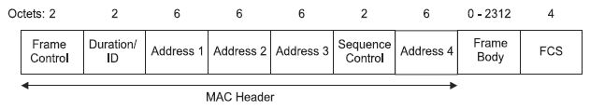
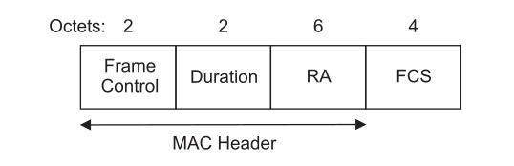
6
PART I
IEEE 802.11b STANDARD COMPLIANCE
6
Standard compliant DATA/ACK Packet Structure
Distributed coordination function (DCF) employing a Carrier Sense Multiple Access with Collision Avoidance (CSMA/CA) Protocol
DATA
[IEEE]
ACK
[IEEE]

Slide 7
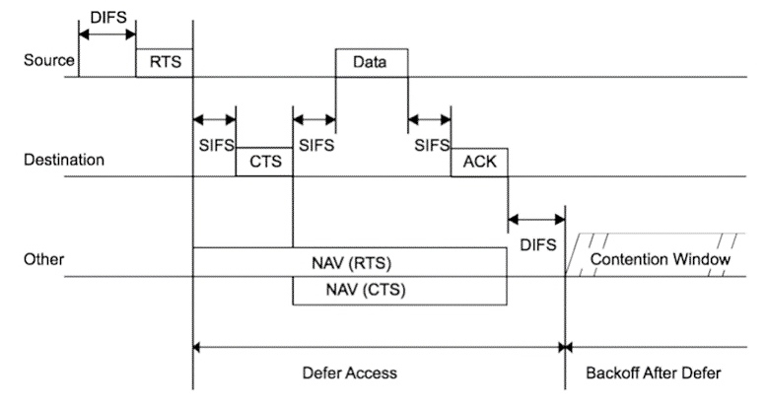
PART I
7
CLOSER TO FULLY 802.11 STANDARDS COMPLIANT MAC
7
RTS/CTS/DATA/ACK and NAV setting
  Virtual Carrier Sensing
    Hidden Terminal Problem
    Other Txs do not sense channel for amount of time specified in Duration field

Slide 8
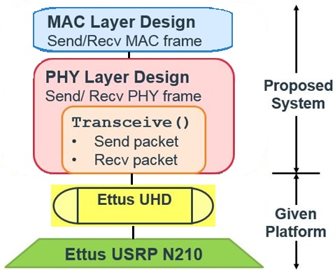
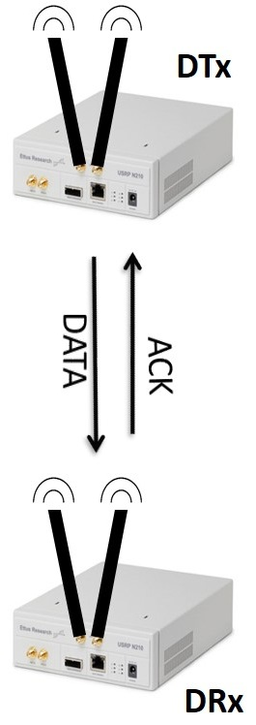
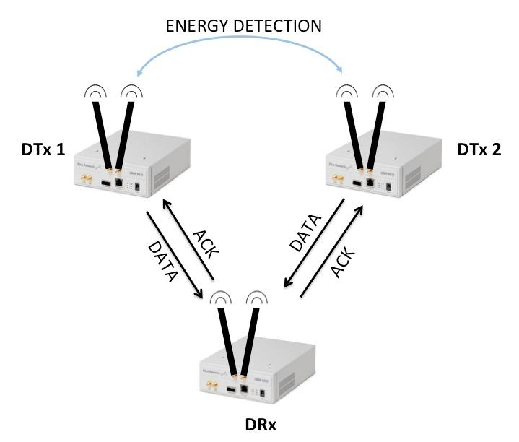
PART I
8
SYSTEM COMPONENTS
SYSTEM DIAGRAM
TWO-NODE SYSTEM
THREE-NODE SYSTEM
Notes:
Define DTx/DRx
Two-Node System: DTx must sense channel before access, but, it does not have to contend for channel access.
Three-Node System: Two bi-directional links (2 DTxs & 1 DRx) exchange DATA and ACK packets.
The MAC Layer helps mitigate packet collisions by resolving contention among the DTxs when accessing the common channel.

Slide 9
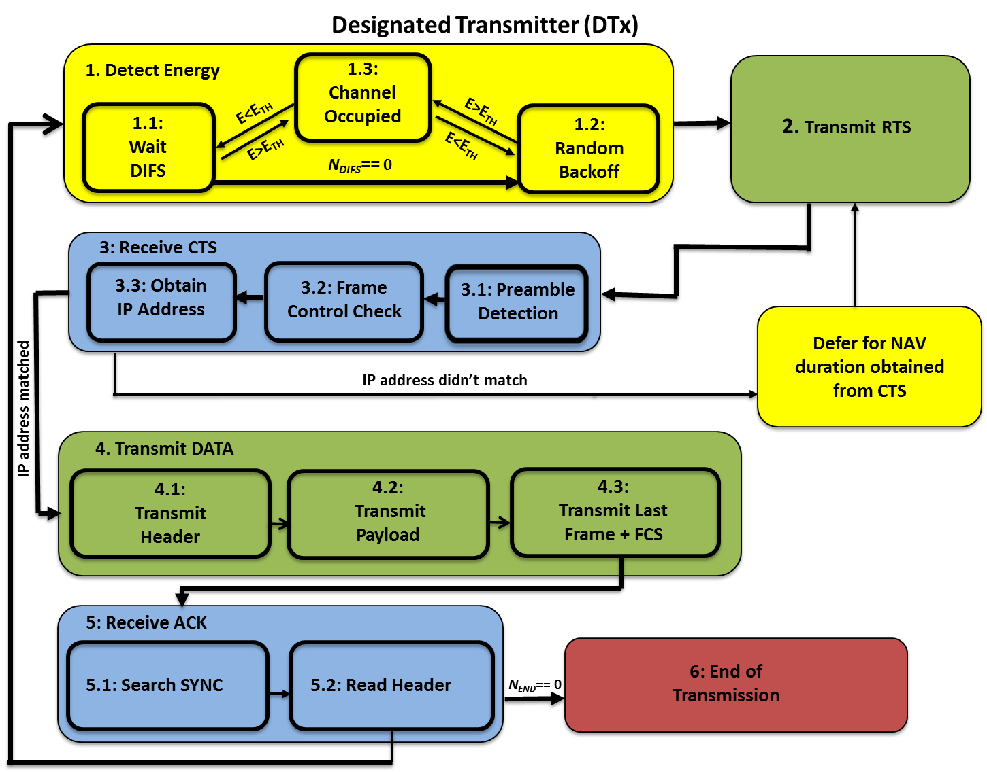
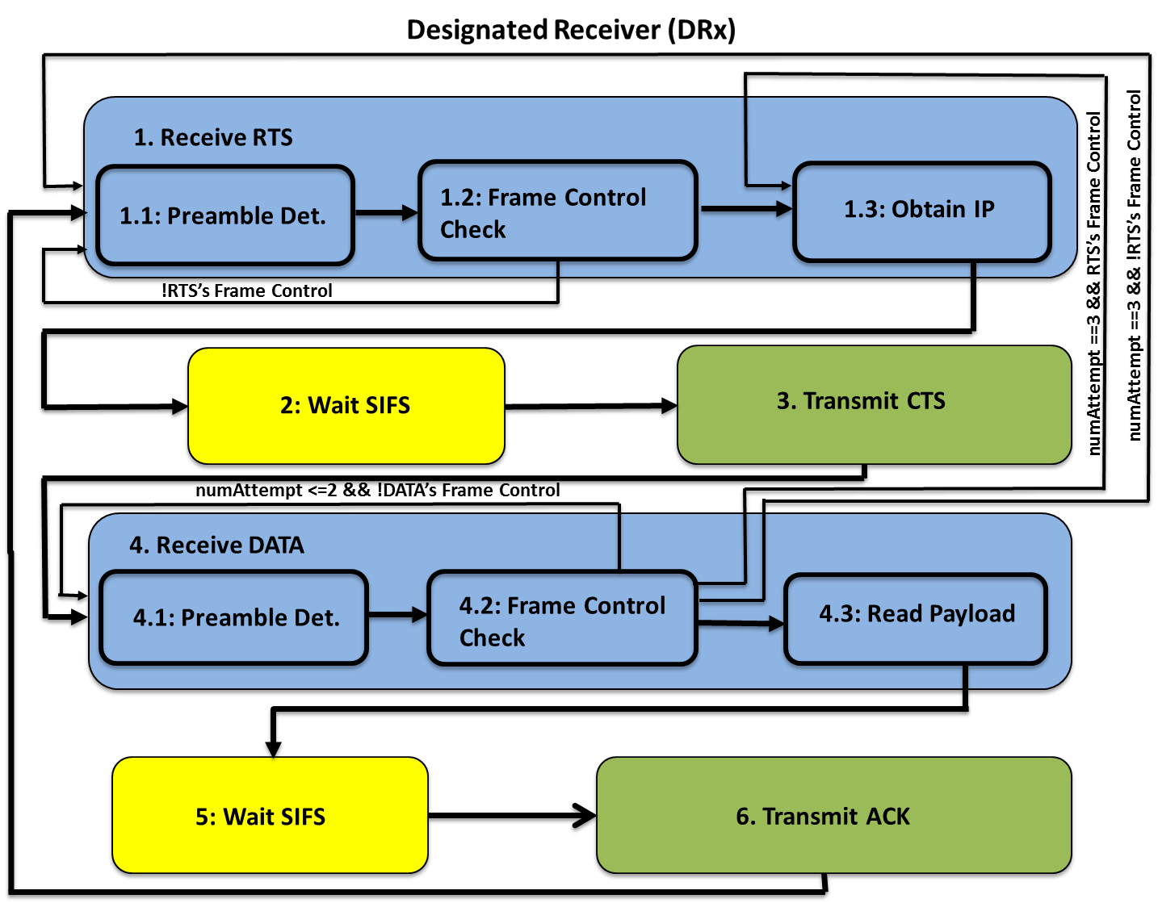
PART I
9
CLASSICAL DATA/ACK WITH OPTIONAL RTS/CTS
9
Notes:
FSM
Yellow, Blue, Green?

Slide 10
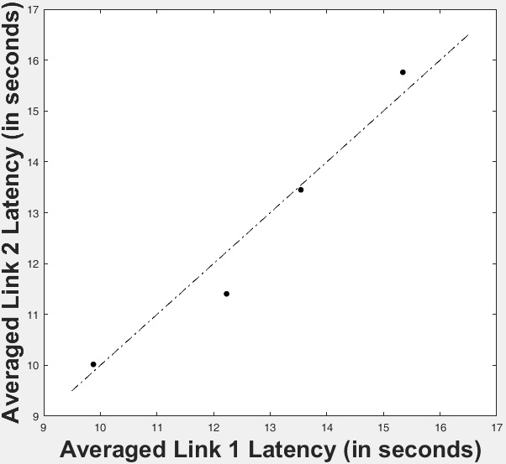

PART I
10
MAC LAYER FAIRNESS
10
In conclusion, the MAC Layer enables and enforces fairness among the two DTxs in accessing a common channel.
Ideal System

Slide 11
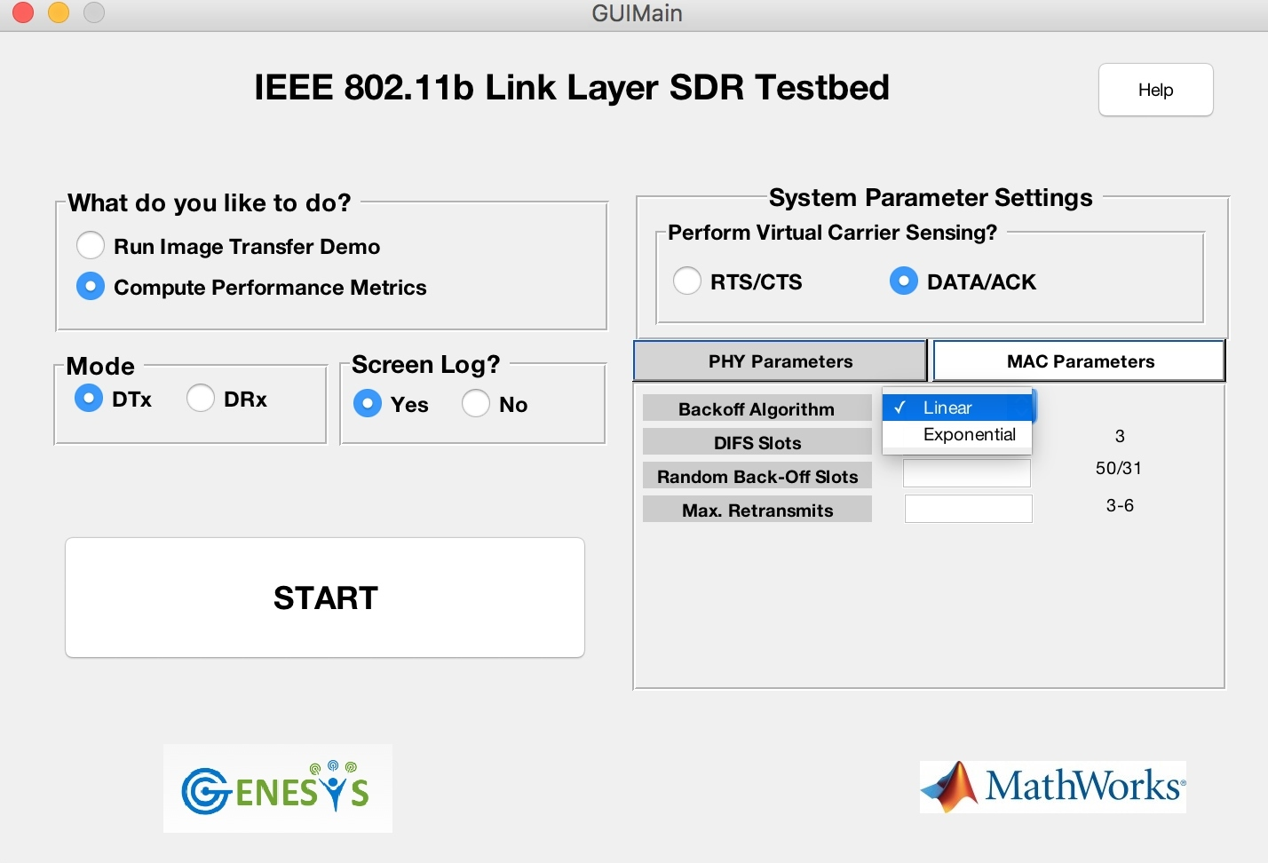
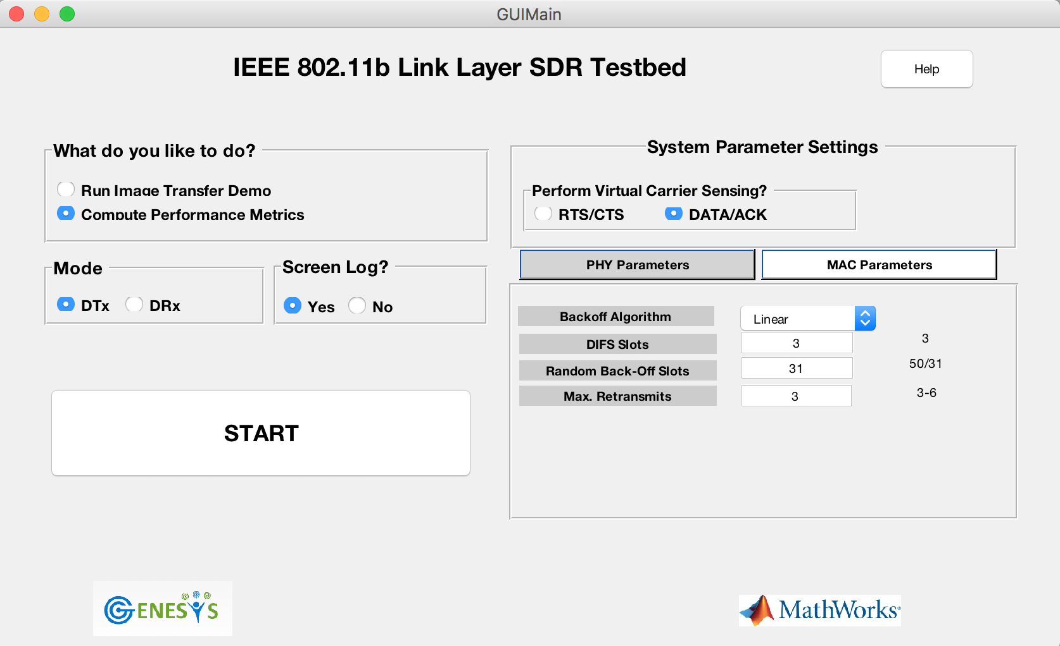
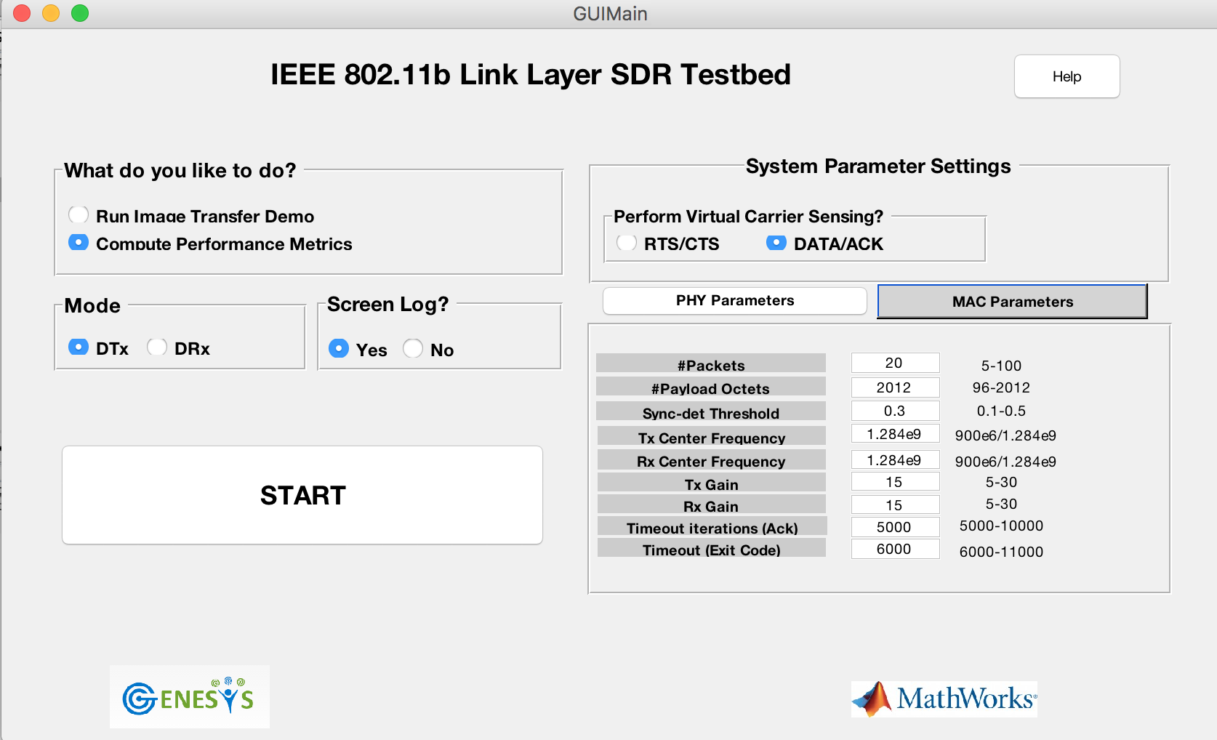
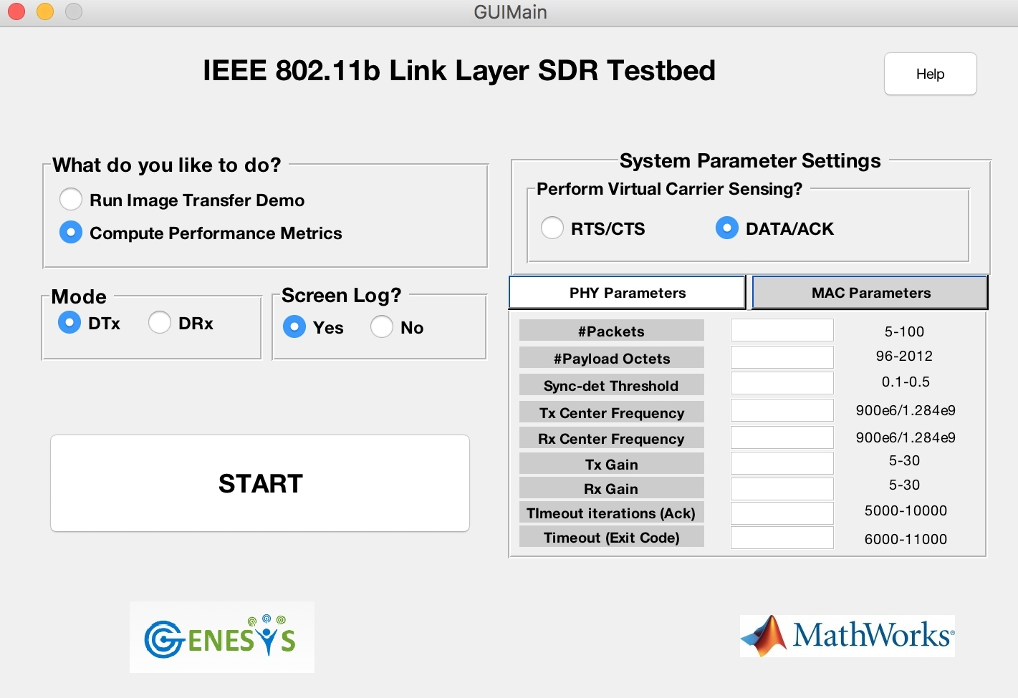
PART I
11
GUI – PANEL FOR PHY & MAC PARAMETERS
11
Notes:
Identified important PHY/MAC parameters.
Default settings of parameters are the recommended settings.
Help PDF gives the context and details the selection criteria of the parameters.

Slide 12
12
PART II
12
DYNAMIC SPECTRUM SWITCHING BETWEEN mmWAVE & THz SMALL CELLS
A. S. Cacciapuoti, R. Subramanian, M. Caleffi, and K. R. Chowdhury, “Software-Defined Network Controlled Switching between Millimeter Wave and Terahertz Small Cells”, IEEE Transactions on Vehicular Technology (submitted on Feb. 9, 2017).
Completed Work

Slide 13
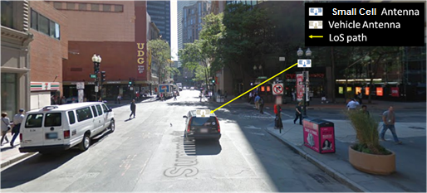
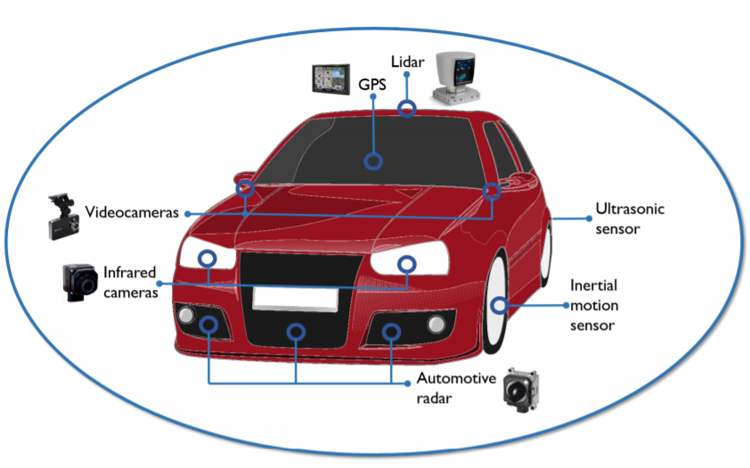
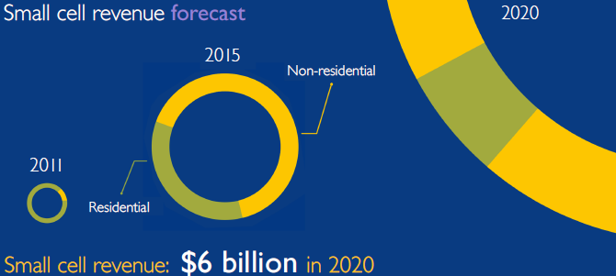
PART II
5G V2I COMMUNICATIONS
13
[A]
[B]
Outdoor small cell deployments proliferate starting 2017
Employ a combination of vehicular networks and wireless, short-range access mmWave & THz links for massive vehicle-to-infrastructure data transfers
[A] J. Choi, V. Va, N. Gonzalez-Prelcic, R. Daniels, C. R. Bhat and R. W. Heath, "Millimeter-Wave Vehicular Communication to Support Massive Automotive Sensing," in IEEE Communications Magazine, vol. 54, no. 12, pp. 160-167, December 2016.
[B] “Market status statistics - Mobile Experts.” [Online]. Available: http:// http://scf.io/en/documents/050_-_Market_status_report_-_Mobile_Experts.php
Notes:
A car with many safety-related automotive sensors
5G vehicular networks envisions cars with advanced sensing/communication capabilities
Driver-less cars, City-scale traffic optimization and Data backhauling.
Gbps rates not attainable in DSRC/4G
Massive spectrum bandwidth available at mmWave and THz frequencies.
Particularly, [0.1-10] THz range can be used to realize data showers

Slide 14
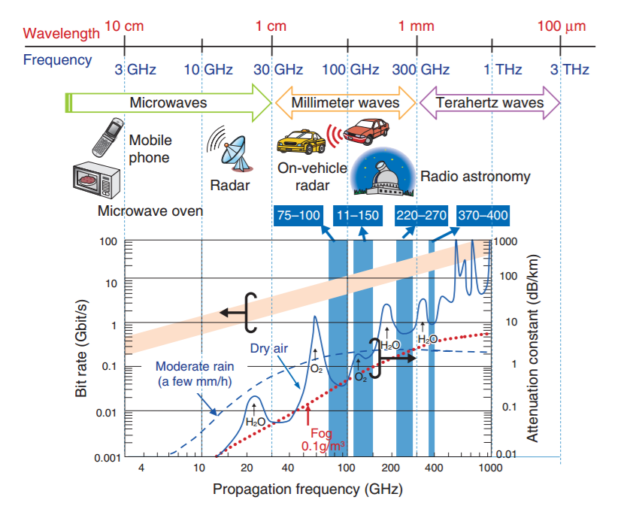
PART II
FEATURES OF mmWave & THz BANDS
14
Both frequency ranges practically need directional transmission, accurate synchronization and experience occasional channel induced outages that may lead to bursty errors.
Naoya Kukutsu et.al. "Overview of Millimeter and Terahertz Wave Application Research", NTT Technical Review, Vol. 7 No. 3 Mar. 2009.
Notes:
Both frequency ranges practically need directional transmission, accurate synchronization and experience occasional channel induced outages that may lead to bursty errors.
Starry, Boston based startup, was recently covered in IEEE Spectrum for they have delivered data rates of 200 Mb/s (stream UHD 4K TV shows) over 1.5 kilometer range at 37 GHz to beta users even in extreme non-line-of-sight conditions. < $85 a month. Compare it to average broadband network in the United States that offers average download speeds of just 55 megabits per second.

Slide 15
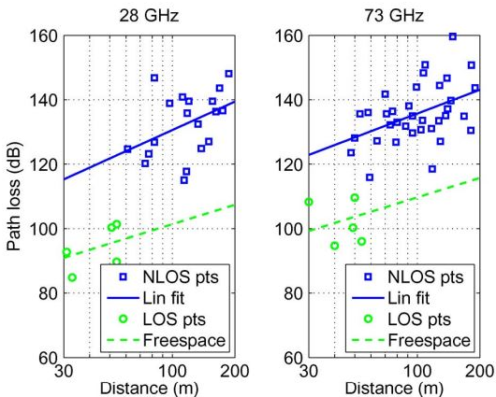
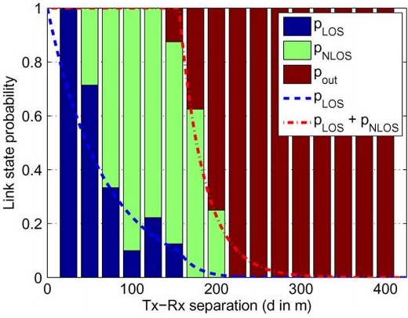
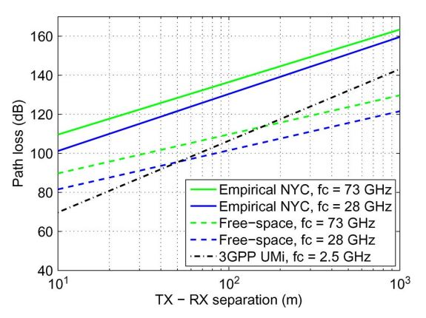
15
PART II
mmWAVE CHANNEL MODEL
15
Linear fit of estimated path losses [2]
Comparison of distance-based path loss models [2]
Fitted curves and the empirical values at 73 GHz [2]
~20-25 dB
~30 dB
~30 dB
~20-25 dB
Omnidirectional path loss ~20 to 25 dB higher than the 3GPP urban microwave [1]
Free-space path loss ~30 dB less than Empirical NYC (at d = 100 m)
Outage events certain for distances > 200 meters
[1] M. R. Akdeniz et al., "Millimeter Wave Channel Modeling and Cellular Capacity Evaluation," in IEEE Journal on Selected Areas in Communications, vol. 32, no. 6, pp. 1164-1179, June 2014.
[2] T. S. Rappaport, G. R. MacCartney, M. K. Samimi and S. Sun, "Wideband Millimeter-Wave Propagation Measurements and Channel Models for Future Wireless Communication System Design," in IEEE Transactions on Communications, vol. 63, no. 9, pp. 3029-3056, Sept. 2015.
Notes:
mmWave: According to the experiments, the probability of having an outage event is null for distances smaller than 150m, but it increases up to 0.7 for distances around 200m.
Largely due to decreased antenna aperture at mmWave frequencies
Path-loss can be entirely compensated with sufficient beamforming.
Exploit large arrays to create pencil beams.
B. Barring outage events, beamforming when applied on both transmitter and receiver, the effective path loss can be even lower in the mmW range.
MmWave signals are sensitive to blockages, e.g. concrete buildings, foliage
C. LOS range is ~150 meters
C. a. Measurement data is based on 42 TX-RX location pairs with distances from 30 m to 420 m at 28 GHz. Transmit powers between 15 and 30 dBm
C. b. Outage: no link between the TX and RX i.e. the path loss in either the LOS or NLOS state is sufficiently large.
D. One direct path dominant in the LOS
Multi-path is sparse even in NLOS
Higher Sampling rate
Higher Power Consumption
The term millimeter-wave generally refers to the frequency range from 30 GHz to 300 GHz because the corresponding wavelength is between 10 mm and 1 mm, and the term subterahertz refers to the frequencies below 1 THz. The millimeter-wave/sub-terahertz frequency range includes molecular vibration frequencies and absorption bands of the atmosphere and common materials and is therefore important for fundamental applications. This frequency range is also useful for technological applications, such as imagers and radars. Imaging at these frequencies can be used to detect concealed weapons or explosives and reveal features in skin, teeth, and solid organs
There are many wide and unallocated frequency bands in the millimeter-wave/subterahertz frequencies that are attractive for wideband applications. The low frequency bands (below 10 GHz) are narrowly divided and have been legally appropriated for various existing applications, making it difficult to accommodate the wide bandwidth requirements of emerging applications. For example, a 10 Gbps BPSK communication system requires a bandwidth of approximately 20 GHz around the carrier frequency.
Signal suffers from higher attenuation due to
Higher Frequency.
Molecular Absorption due to mechanical resonant frequencies in the band.
Higher bandwidth of the order of GHz.

Slide 16
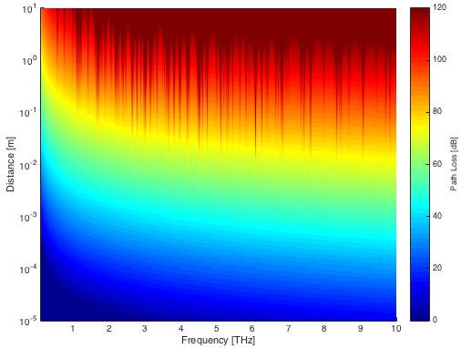
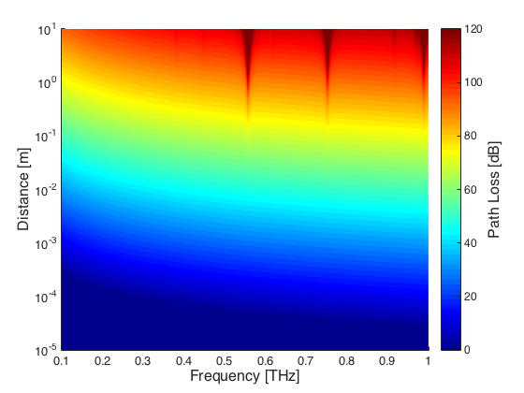
PART II
THz CHANNEL MODEL
16
Path loss in THz bands are much higher compared to mmWave
  At 1THz, path loss is 100 dB even for Tx-Rx separation of 1 m
  Increases with both the distance and the frequency
THz channel is highly frequency-selective
  Signal propagation is mainly affected by water vapor molecular absorption
  Several peaks of attenuation (~40dB!) can be observed due to the molecular absorption loss
  Further, molecular absorption introduces colored noise.
Several transmission windows with varying widths
    Defined by the molecular composition of the medium
    Width of the spectral windows dwindles as the center frequency increases [4]
No experimental characterization for NLoS transmissions in the THz band.
Terahertz band (around 0.1-10 THz)
Terahertz band (around 0.1-1 THz)
Notes:
Choice of THz band
Spectrum range [0.8-0.9] THz represents a suitable band for THz communications up to 10 meters

Slide 17
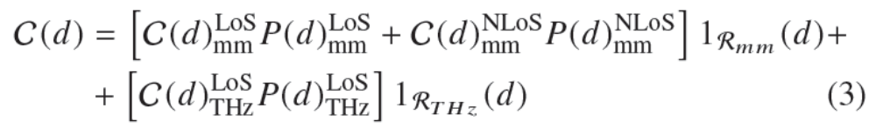
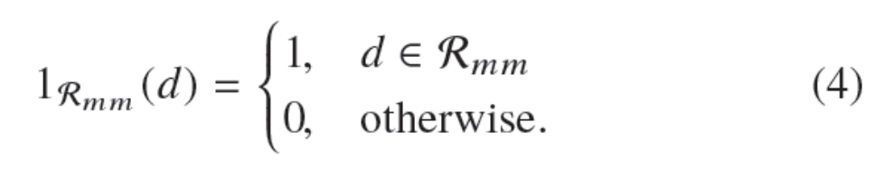



PART II
CAPACITY MODELING – THEORETICAL ANALYSIS
17
Subscripts (mm, THz) : access mode used
Superscripts (LoS, NLoS) : existing propagation condition
mmWave link
THz link
Notes:
C(d): Closed-form expression for the channel capacity for a given distance d

Slide 18
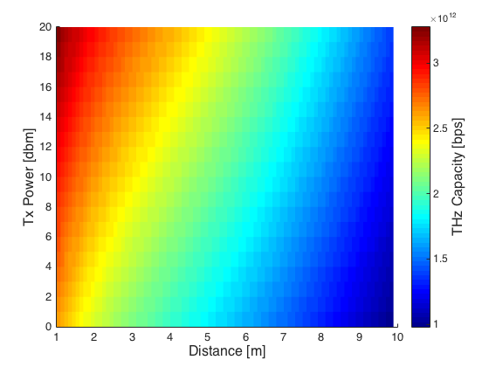
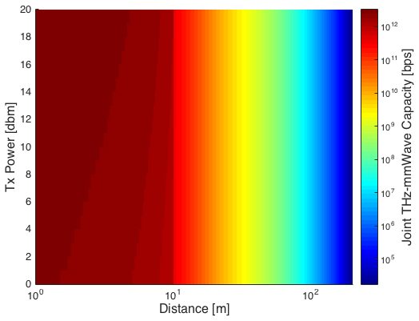
PART II
DISTANCE-DEPENDENT CAPACITY
18
CAPACITY FOR THz LINK AT 0.85 THz
CAPACITY ACHIEVABLE BY ADOPTING THE PROPOSED THz/mmWAVE MODE SELECTION
Notes:
Choice of THz band
Spectrum range [0.8-0.9] THz represents a suitable band for THz communications up to 10 meters

Slide 19
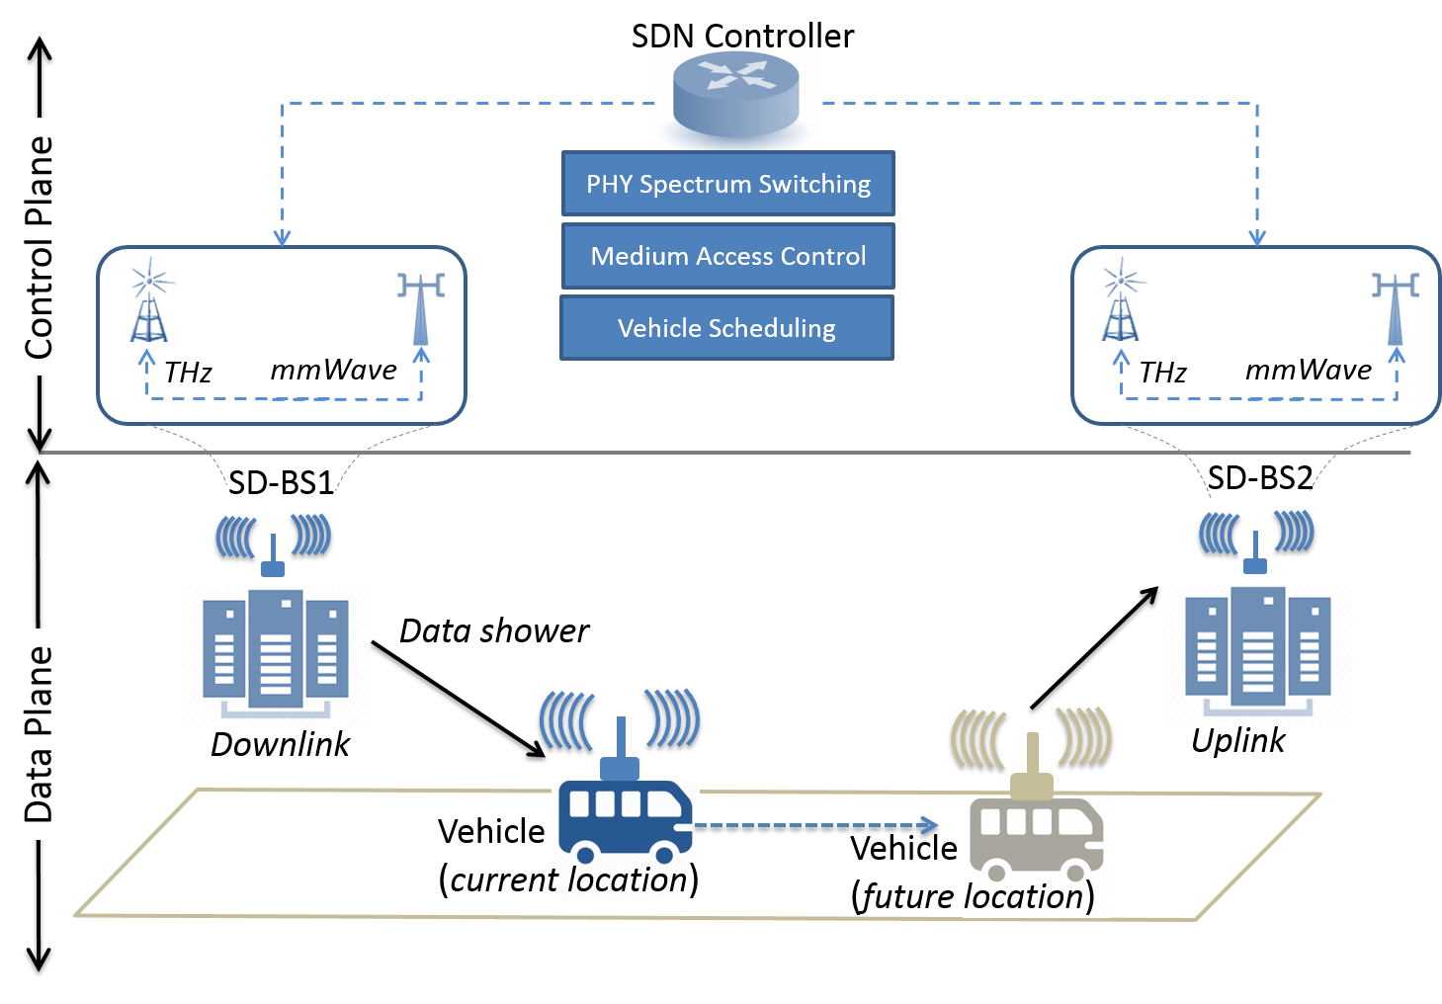
PART II
19
DATA CENTER TRAFFIC BACKHAULING
NETWORK
ARCHITECTURE
Serious challenges in backhauling small cells
Fiber is expensive and can become congested making it worse for low-latency applications.
Inherent advantage in using vehicles as mobile data caches.
Wireless backhauling suffers from reduced likelihood of LOS conditions in urban settings
Notes:
Vehicles: data mules; Infrastructure: installed roadside towers
Necessitates installation of expensive networking equipment, miles of fiber connecting data centers.
Wires are a limiting factor for many technologies. Google Fiber, Google's own gigabit internet service, is looking to ditch physical fiber-optic cables in favor of a wireless solution that could help the service roll out to more cities more quickly (and more cheaply, too, since laying down miles of fiber-optic cables and digging up service lines or upgrading above-ground lines is extremely costly).
This type of data is usually not interactive, may be delay tolerant.

Slide 20
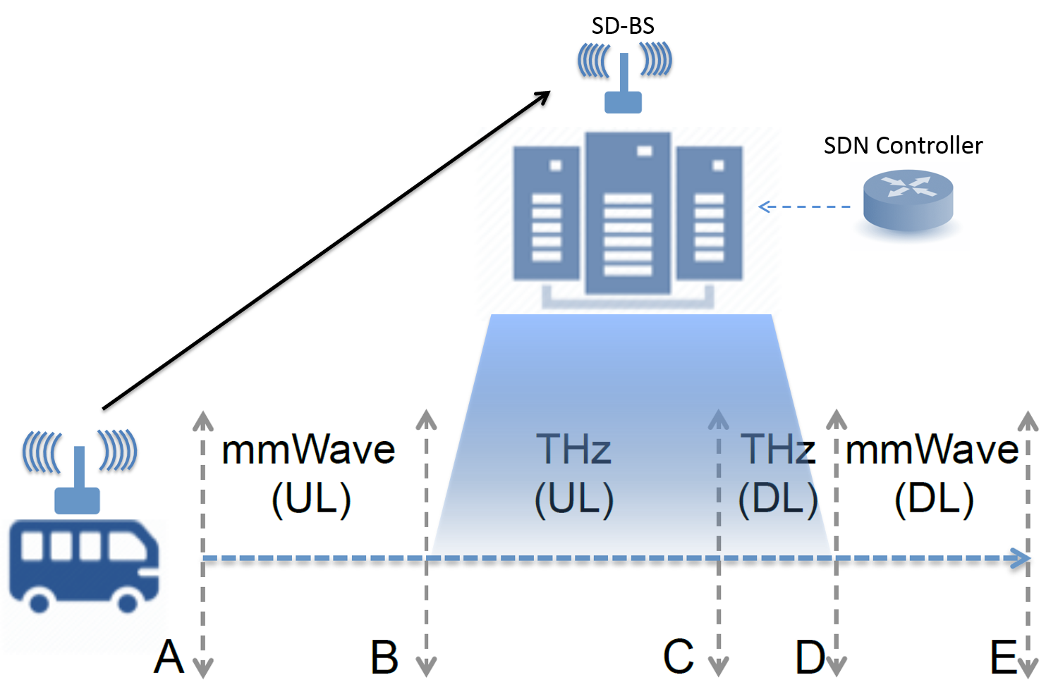
PART II
DISTANCE-DEPENDENT MODE SWITCHING
20
How do we select between the two types of wireless access?
Vehicle moves closer to the SD-BS before pulling away again.
d_{mm} >> d_{THz}
Communicating node pair always defaults to THz communication when d ≤ d_{THz}
Selecting durations for uplink (A-C) and downlink (C-E)
B-D: THz communication
A-B & D-E: mmWave communication
Notes:
THz bands allow transmission rates of several orders of magnitude higher than mmWave. We use THz mode whenever possible.
Let d_{mm} and d_{THz} respectively be the max. distance between a pair of nodes at which communication becomes possible for the mmWave and the THz channels.
Let the separation distance be d

Slide 21
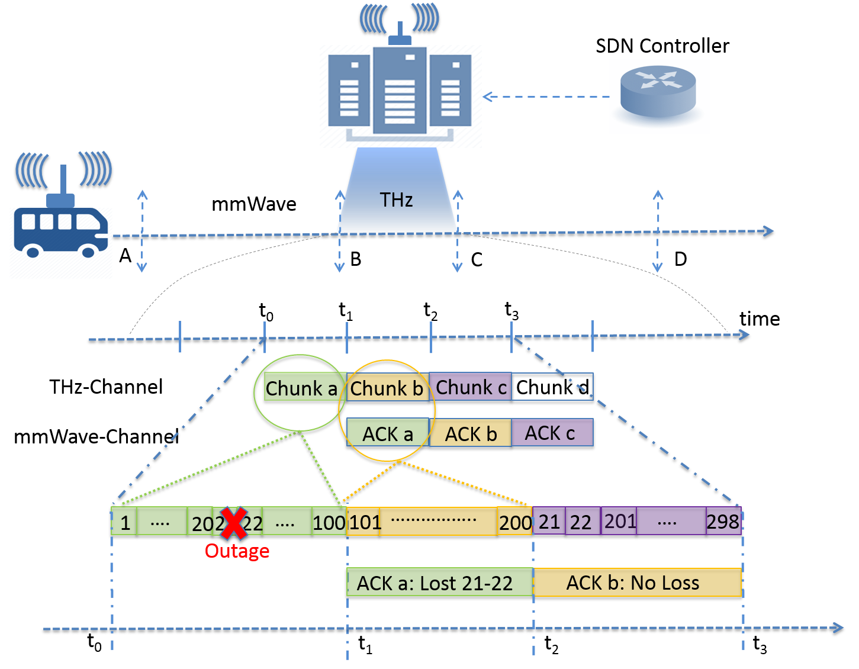
PART II
PROTOCOL OVERVIEW: UPLINK PHASE
21

Slide 22
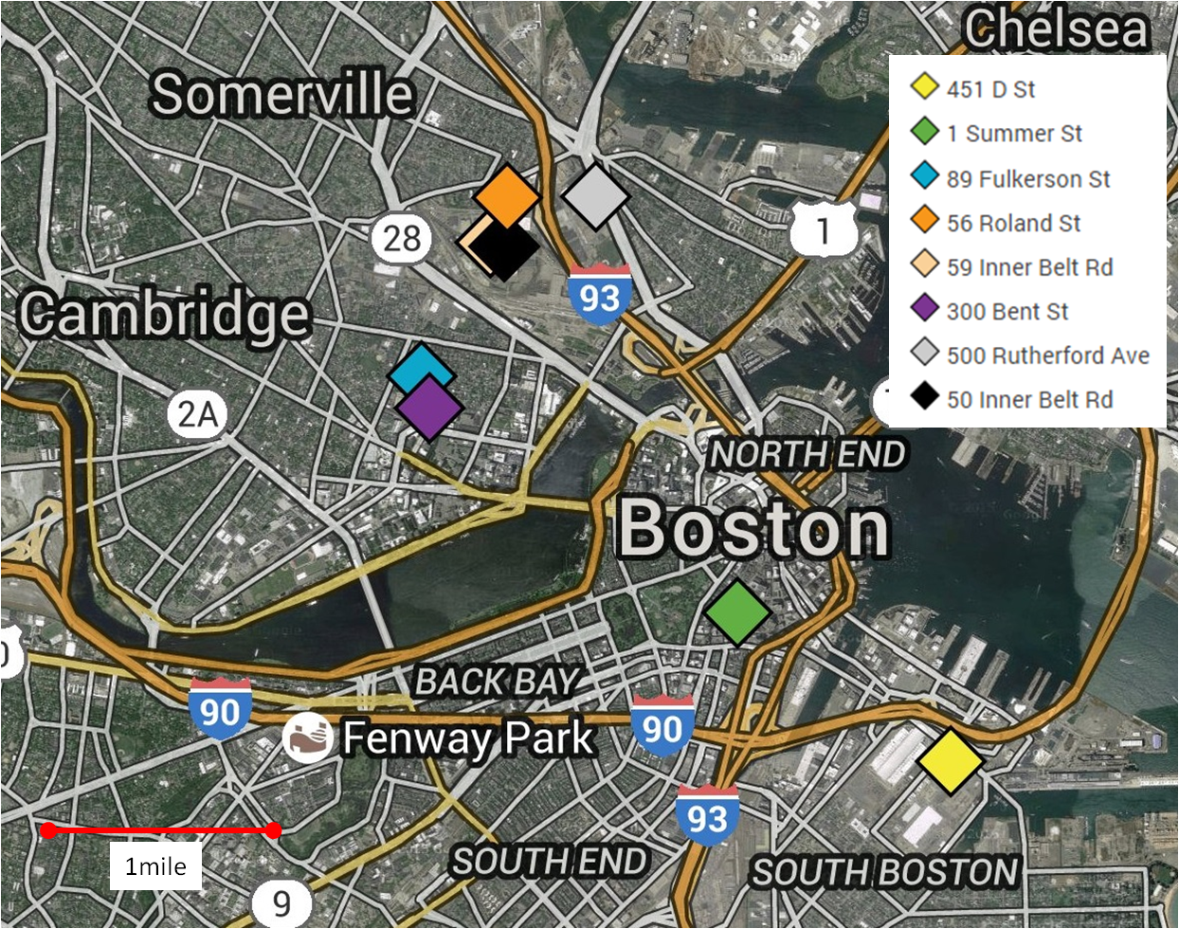
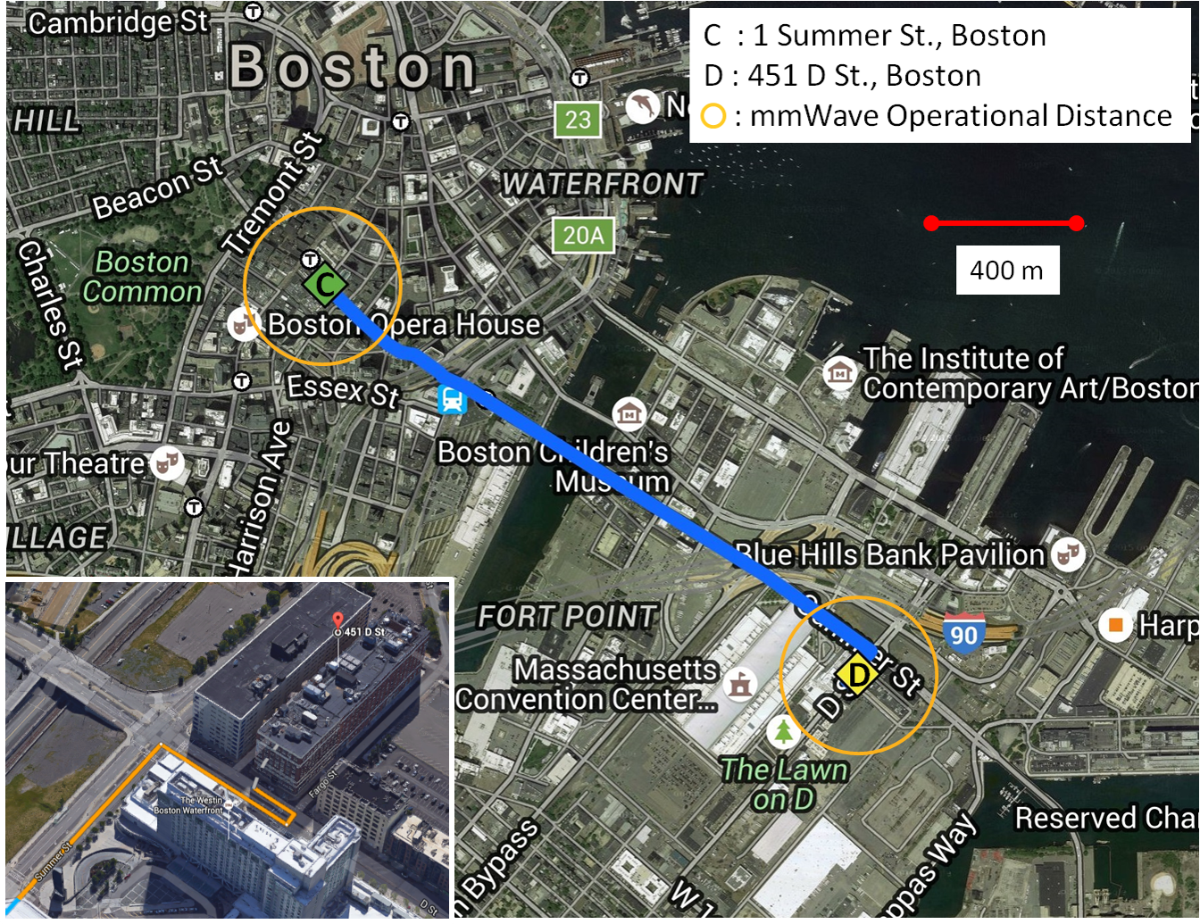
PART II
22
22
DATA CENTER LOCATIONS IN BOSTON AND SUGGESTED ROUTE BETWEEN TWO DATA CENTERS
XO Communications
Markley Group
Notes:
1. Network Scenario
Two data centers located in downtown Boston: the first is located at 451 D St., owned by Markley Group LLC, and the second is located at 1 Summer Street, owned by XO Communications.

Slide 23
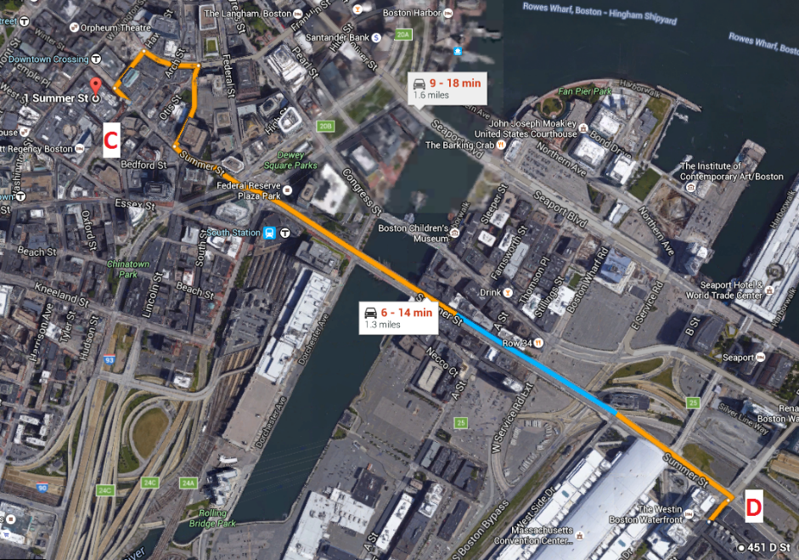
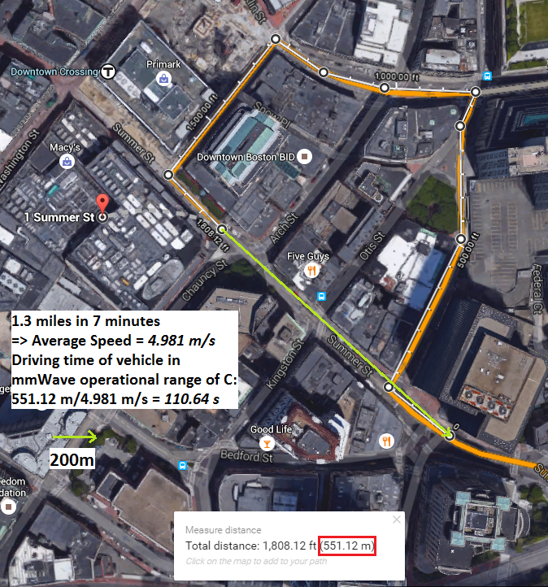
PART II
SIMULATION-BASED CASE STUDY
23
Analyze the driving route
Identify geometry of the scene and extract mobility patterns

Slide 24
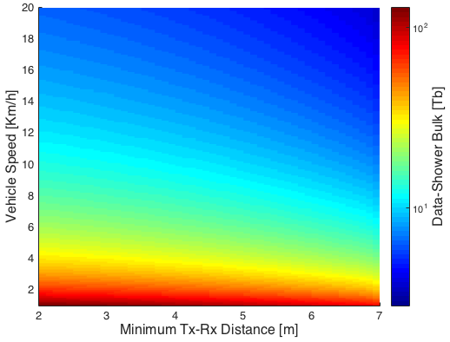
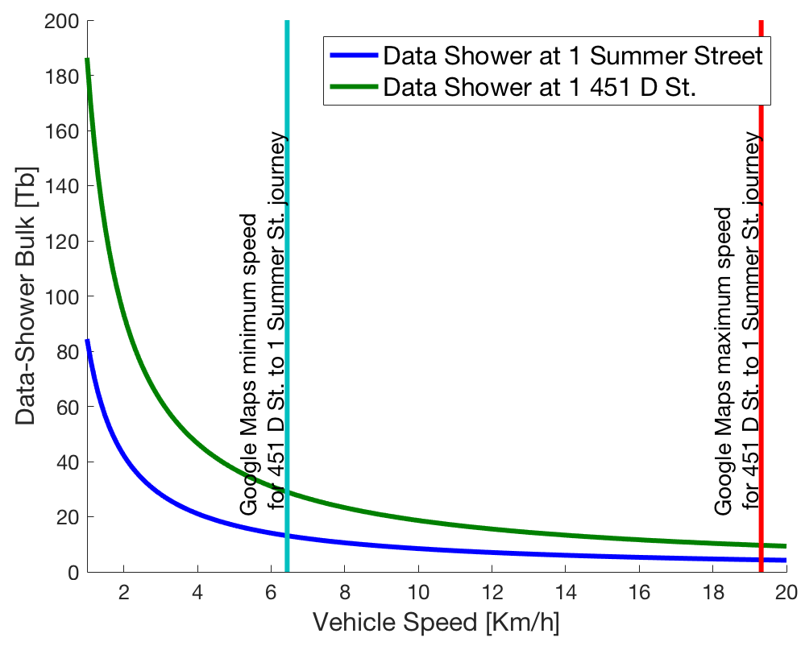
PART II
24
24
24
DATA SHOWER BULK
24
DATA SHOWER AS A FUNCTION OF MINIMUM SEPARATION DISTANCE AND AVERAGE MULE VELOCITY
DATA SHOWER AS A FUNCTION OF AVERAGE MULE VELOCITY

Slide 25
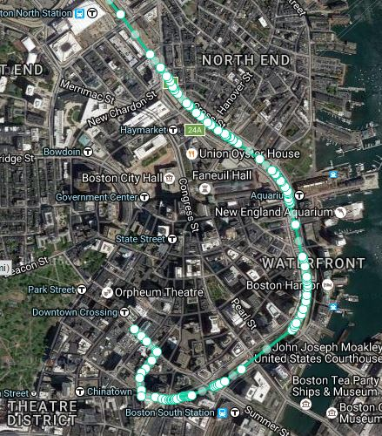
PART II
SUMMARY - CHALLENGES TACKLED
25
mmWave and THz Channel Models not available for capacity modeling
    Channel parameters either obtained from literature or derived from first principles
Cannot obtain real-world geo-coded data programmatically
    Google generates revenue from their data
Non-uniform and noisy GPS samples
Translate GPS samples to real-world distances
Notes:
e.g. Obtain GPS co-ordinates for the driving route taken by a car from Northeastern Univ. to Tufts University

Slide 26
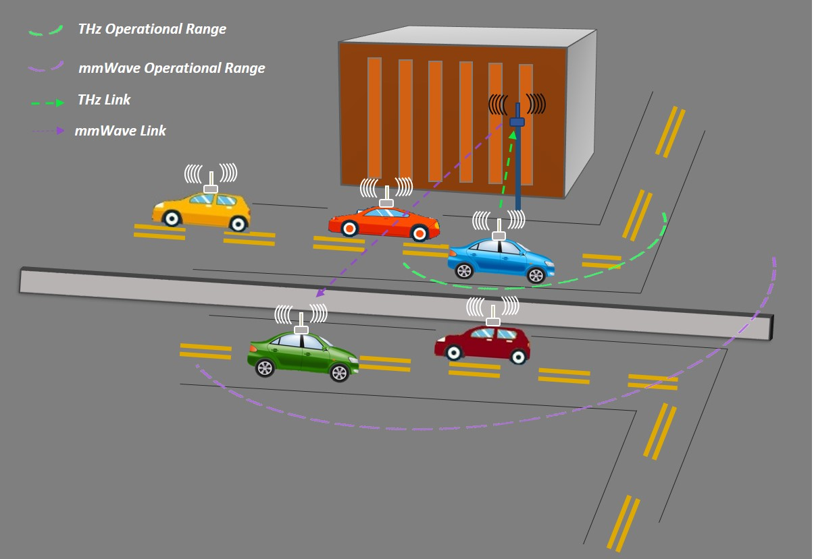
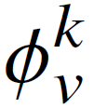
PART II
26
26
26
26
MULTI-VEHICLE SCHEDULING
Objective:
Maximize the total number of bits exchanged between the infrastructure tower and the vehicles.
Constraints:
(1) Avoid scheduling a vehicle that already completed its communication needs
(2) At most one vehicle is scheduled at any given time
INPUT
V: Number of Vehicles
d(t): Distance vs Time Profile
D_{v}: number of bits ↑ to/↓ from infrastructure tower
OUTPUT
: scheduling-state of the v^{th} vehicle at time slot k

Slide 27

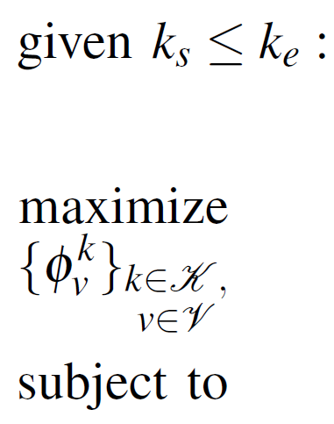
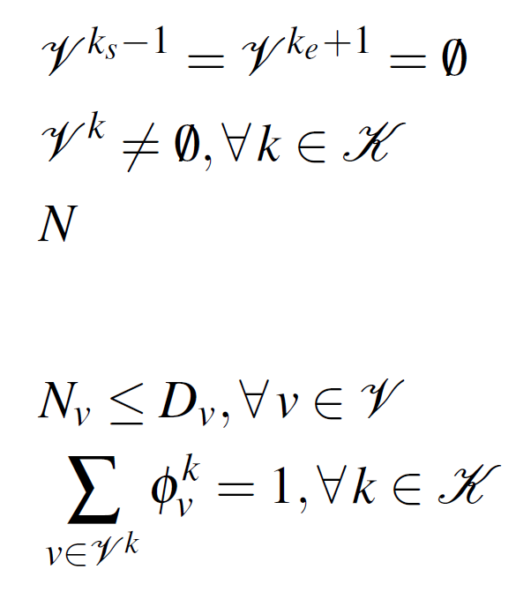
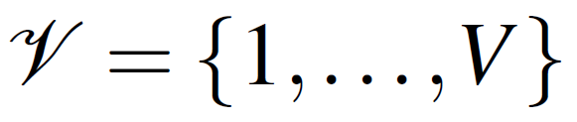
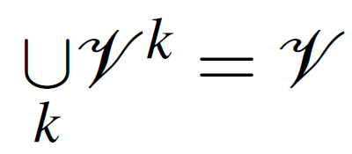
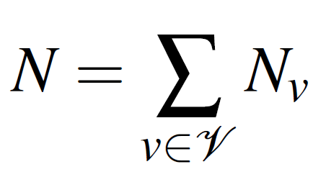
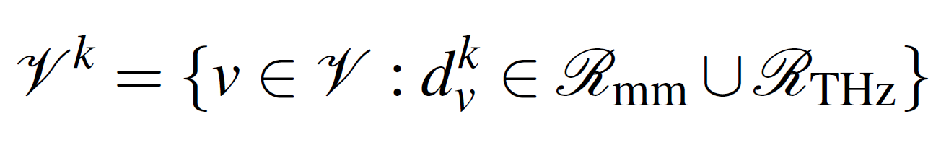
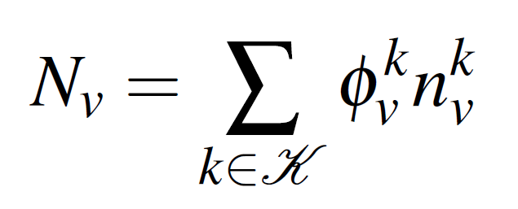
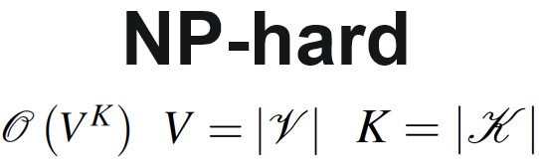
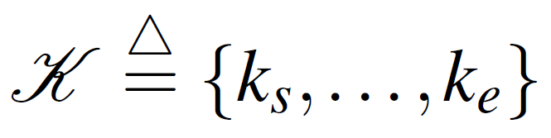
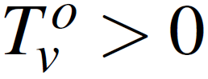
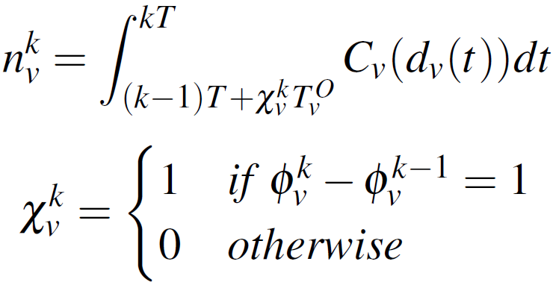
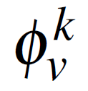
PART II
MULTI-VEHICLE SCHEDULING
27
27
27
27
Notation:
Problem Formulation:
Overhead time:
Scheduling State:

Slide 28



PART II
28
OUR GREEDY ALGORITHM
28
28
28
Schedule vehicles that can complete their data needs
Remove such empty slots
Schedule vehicles in time slots that maximizes the number of exchangeable bits

Slide 29







PART II
29
29
29
29
TIME COMPLEXITY
&
EXHAUSTIVE SEARCH
→
Exponential time complexity
GREEDY ALGORITHM
→
Polynomial time complexity

Slide 30


PART II
30
30
SCHEDULING PERFORMANCE ANALYSIS
30
Naive approach of scheduling vehicles on first-come-first-serve basis will clearly be sub-optimal

Slide 31

PART II
31
31
31
31
RELATIVE PERFORMANCE OF THE GREEDY ALGORITHM
5 vehicles; v ~ [3-7] m/s; d_{min} = 5 m
Time Horizon = 2 mins = 1387 slots
1000 Monte Carlo runs
Error bars at 95% confidence intervals
Random algorithm accumulates coordination overhead time
Exhibits excellent performance overall
Optimal performance for overhead time <10⁻²T

Slide 32

PART III
32
32
32
32
RESOURCE ALLOCATION SCHEME FOR mmWAVE V2I NETWORK
Notes:
“multiple vehicles”
Short transmissions occupying large bandwidth

Slide 33




PART III
RELATED WORK - FAST BEAM CONFIGURATION
33
[B]
[A]
[D]
[C]
[A] Ioannis Mavromatis et. al., “Beam Alignment for Millimetre Wave Links with Motion Prediction of Autonomous Vehicles,“ to appear in Proc. of IET Colloquium on Antennas, Propagation & RF Technology for Transport and Autonomous Platform (ArXiv e-prints, Feb. 2017)
[B] N. González-Prelcic, R. Méndez-Rial and R. W. Heath, "Radar aided beam alignment in MmWave V2I communications supporting antenna diversity," 2016 Information Theory and Applications Workshop (ITA), La Jolla, CA, USA, 2016, pp. 1-7.
[C] V. Va, T. Shimizu, G. Bansal and R. W. Heath, "Beam design for beam switching based millimeter wave vehicle-to-infrastructure communications," 2016 IEEE International Conference on Communications (ICC), Kuala Lumpur, 2016, pp. 1-6.
[D] N. Gonz´alez Prelcic, A. Ali, V. Va, and R. W. Heath, Jr, “Millimeter Wave communication with out-of-band information,” ArXiv e-prints, Mar. 2017.
Notes:
Out-of-band sources to reduce beam alignment overhead [B]
State your assumption -> You got accurate locations of the Tx and Rx antenna, which lets you compute Theta and Phi.

Slide 34

PART III
MOTIVATION FOR DIRECTIONAL MAC
34
34
34
Multi-user concurrent access demands resolving the simultaneous requests
Impaired Clear Channel Assessment (CCA) due to directional beams
Concurrent beams required at BS to resolve such requests → Use hybrid beamforming
The finite time-frequency resource must then be shared efficiently
Notes:
Initial user association phase
CSMA/CA will yield poor performance resulting from packet collisions
Let’s say, at the BS, the time that is available as T_{tot} and bandwidth as B_{tot}. We can represent this resource as a ordered tuple (T_{tot} ,B_{tot} ). It can be conveniently visualized as a rectangle.

Slide 35

PART III
DIRECTIONAL MAC PROTOCOL
35
35
35

Slide 36



PART III
36
36
36
36
RESOURCE ALLOCATION SCHEME
36
0/1 2D Knapsack Problem – Strongly NP-hard
max $\sum_{i∈K}{{{α_{i}×T}_{i}×B_{i}×log}_{2}{(1+{SNR}_{i})}}$)
s.t. $\sum_{i∈K}{{α_{i}×T}_{i} ≤}$ $T_{tot}$
&$\sum_{i∈K}{{α_{i}×B}_{i} ≤}$ $B_{tot}$
$$B_{tot}$$
MS₁
?
$$T_{tot}$$
The objective function above disregards the geometrical constraints
Not just identify which items to pack; Also specify the position of the rectangles
In that regard, 2D Rectangle Bin Packing Problem, a classical problem in combinatorial optimization, specifies the relevant objective function

Slide 37
PART III
37
RECTANGLE BIN PACKING PROBLEM
37
37
37
RB^{t} := (T_{tot} ,B_{tot} )
T_{tot}
Resource Blocks: Ordered Tuples!
Frequency
MS₁
B_{tot}
MS₄
t = T
Time
RSB_{k} := (T_{k} ,B_{k} )
RSB_{k} := (B_{k} ,T_{k})
^{t}
T₁
T₂
MS₁
MS₃
B₁
MS₂
. .
. .
B₂
Notes:
(T_{tot}, B_{tot}) represent the size of the rectangular bin
Objective is to maximize resource utilization at the BS.

Slide 38
PART III
PACKING CRITERIA
38
Orthogonal packing
Non-overlapping
Fixed orientation with no rotations allowed
Non-Guillotine Packing
T_{tot}
Frequency
MS₁
B_{tot}
Time
MS₄
t = T
T₁
T₂
MS₁
MS₃
B₁
MS₂
. .
. .
B₂
Notes:
Beam Locking

Slide 39
PART III
EFFICIENT MULTIUSER SCHEDULING
39
39
RB^{t} := (T_{tot} ,B_{tot} )
T_{tot}
Objective Function: Minimize Trim Loss
T₂
MS₃
Frequency
MS₂
MS₄
B_{tot}
MS₁
B₄
What is the minimum resource unit that the BS can handle?
T₁
t = T
Time
J. Jylänki, “A Thousand Ways to Pack the Bin – A Practical Approach to Two-Dimensional Rectangle Bin Packing,” 2010. [Online]. Available: https://github.com/juj/RectangleBinPack
Notes:
What is MRU?
Size of MRU requires knowledge of
sides of the rectangles: Positive integers

Slide 40




PART III
RADIO FRAME DESIGN
40
40
40
MRU
Requires knowledge of minimum Coherence Time (T_{c}) and Coherence Bandwidth (B_{C})
Delay Spread in the order of ns
NLOS propagation not relevant
Doppler in mmWave operating frequencies is large
Unlike sub-6 Ghz, T_{c} in mmWave is relatively much smaller
At the BS, we set T_{tot} & B_{tot} similar to that of IEEE 802.11 ad std.,
T_{tot} = [100 – 1000] ms
B_{tot} = 2 GHz
F_{PS}
T_{PS}
Δf
T
T = T_{CP} + T_{DATA}
${\text{f}}_{D}^{ max}≪$ Δf $≪$ $\frac{1}{T_{CP}}$
T_{PS} = $\frac{1}{K_{T}}•$ ${\text{T}}_{\text{C}}^{min}$
F_{PS} = $\frac{1}{K_{F}}•$ $B_{\text{C}}^{min}$

Slide 41






PART III
41
41
41
41
COHERENCE TIME (T_{C}) & COHERENCE BANDWIDTH (B_{C})
41
T_{C}
B_{C}
From [A],
From [B],
LOS:
NLOS:
µ_{r} ≈ 0˚
Mean directional RMS delay spread [C] = 7 ns
(considering only the single strongest beam power over all TX-RX location combinations)
0˚ << µ_{r} < 90˚
Vehicle’s beamwidth = θ; Receiver speed = v = 30 m/s;
Carrier frequency = f_{c} = 60 GHz; λ: carrier wavelength;
max. Doppler = f_{D} = v/λ, D = Tx-Rx distance = 50 m; D_{λ} = D/λ; α_{LOS} = angle of arrival of the LOS path; Pointing angle = µ_{r}
Target correlation = R = 0.5
[A] V. Va, J. Choi, and R. W. Heath, Jr., “The Impact of Beamwidth on Temporal Channel Variation in Vehicular Channels and its Implications“, in IEEE Transactions on Vehicular Technology , vol.PP, no.99, pp.1-1, doi: 10.1109/TVT.2016.2622164
[B] H. J. Thomas, R. S. Cole and G. L. Siqueira, "An experimental study of the propagation of 55 GHz millimeter waves in an urban mobile radio environment," in IEEE Transactions on Vehicular Technology, vol. 43, no. 1, pp. 140-146, Feb 1994. doi: 10.1109/25.282274
[C] G. R. MacCartney, M. K. Samimi, and T. S. Rappaport, “Exploiting directionality for millimeter-wave wireless system improvement,” in 2015 IEEE International Conference on Communications (ICC), June 2015, pp. 2416–2422.
Notes:
How do we interpret these models and measurement studies.. These details?

Slide 42



PART III
42
42
42
42
COHERENCE TIME (T_{C}) & COHERENCE BANDWIDTH (B_{C})
42
T_{C}
B_{C}
U[66 MHz,132 MHz]
Head
Tail
U[20 MHz,66 MHz]
p_{Head} = 0.95
[A] V. Va, J. Choi, and R. W. Heath, Jr., “The Impact of Beamwidth on Temporal Channel Variation in Vehicular Channels and its Implications“, in IEEE Transactions on Vehicular Technology , vol.PP, no.99, pp.1-1, doi: 10.1109/TVT.2016.2622164
[B] H. J. Thomas, R. S. Cole and G. L. Siqueira, "An experimental study of the propagation of 55 GHz millimeter waves in an urban mobile radio environment," in IEEE Transactions on Vehicular Technology, vol. 43, no. 1, pp. 140-146, Feb 1994. doi: 10.1109/25.282274
[C] G. R. MacCartney, M. K. Samimi, and T. S. Rappaport, “Exploiting directionality for millimeter-wave wireless system improvement,” in 2015 IEEE International Conference on Communications (ICC), June 2015, pp. 2416–2422.

Slide 43


PART III
SIMULATION ENVIRONMENT
43
43
Ideal Case: Import 3D model of, say, a section of Boston City that has vehicles moving along the streets, turns at intersections and accounts for blockages from vehicles, buildings, pedestrians, foliage
Notes:
Built a simulator in MATLAB. Why?
3D ray tracing software license costs ~$10,000. It supports channel modeling in static scenerios, does not support mobility.

Slide 44

PART III
LINK STATES IN V2I COMMUNIACTION
44
44
44
44
Propagation through buildings not a relevant effect in mmWave urban environment. [B]
Buildings with steel concrete and energy saving windows
Penetration losses ~30 dB (for just 1 wall)
LOS Probability:
3GPP urban microcellular model [A]
Outage Probability:
3GPP
p_{outage} = 1 – p_{LOS} (x)
[A] E. U. T. R. Access, “Further advancements for E-UTRA physical layer aspects,” 3GPP Technical Specification TR, vol. 36, p. V2, 2010.
[B] Yuyang Wang et. al., "MmWave vehicle-to-infrastructure communication: Analysis of urban microcellular networks", ArXiv preprints, Feb 2017.

Slide 45


LAST WORDS
CONCLUSION AND FUTURE WORK
45
45
Addressed several challenges in the design of medium access protocols for short-range wireless networks that can operate in distinct spectrum band(s).
Researchers will greatly benefit from the publicly available code base, protocols, analytical models, algorithms and the insights resulting from simulation-based case studies.
WIRELESS BACKHAUL
μWave/mmWave/THz AERIAL NETWORKS
OPTIMAL 3-D PLACEMENT
THz link
μWave link
DYNAMIC SPECTRUM SWITCHING
mmWave link
Notes:
Remote Areas/Disaster Zone/Stadium

