Slide 1
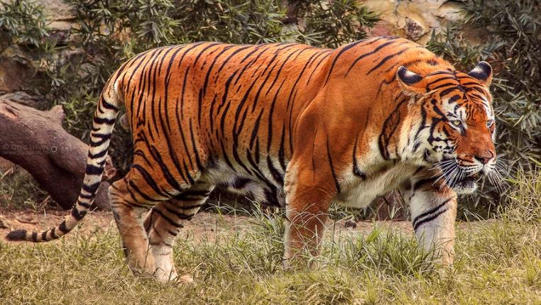
MY TAKE ON TIGER CONSERVATION IN INDIA
The Bengal tiger (Panthera tigris)
Ram Subramanian
SWE, Routing BU
Notes:
Tigers are the largest wild cats in the world.
Tigers are territorial
Tiger is the national animal of India
Unlike lions, tigers are solitary hunters.

Slide 2
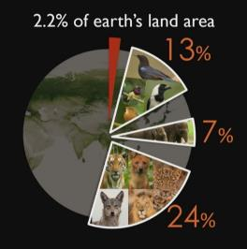
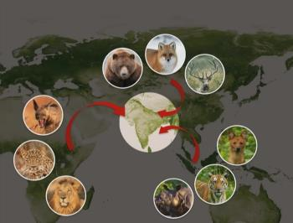
TIGER FACTS YOU MIGHT NOT KNOW ALREADY
Cubs (sub-adults) do mock hunts with their mother as target
Tiger's saliva is a strong antibiotic - constantly licking the wound, it rarely goes septic
Only big cats that find waters irresistible and enjoys swimming
What’s unique about wildlife in India?
India is home to 70 percent of tigers in the world.
India is currently the only country with wild populations of both tiger and lion.
Notes:
Can go 2 weeks between meals; consumes 75 pounds of meat
Oldest fossils of modern tiger date 1.8 million years ago
Got retractable claws
Female tigers tend to be more aggressive
Female tigers stay stay longer with their mother before becoming independent
Pluck the hunted prey before they eat it
Langurs pee on the tigers from tree-top to show their disgust

Slide 3
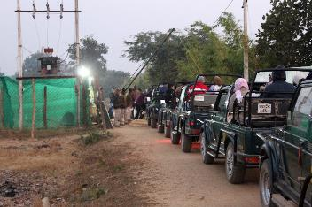
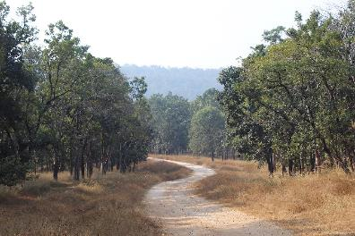
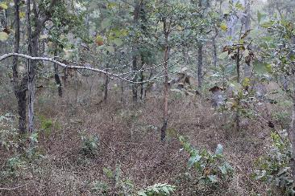
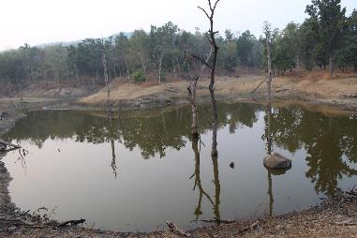
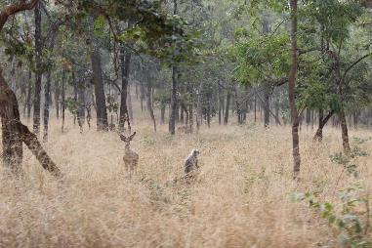

OPEN JEEP SAFARI @PENCH TIGER RESERVE
Buffer Zone
Core Zone
Turia Gate
Notes:
Tiger: Spy in the Jungle focuses on a female tiger and its 4 cubs in the Pench National Park. It is narrated by natural historian David Attenborough.

Slide 4
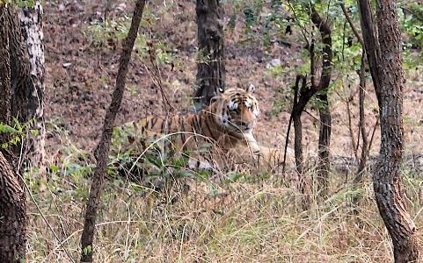
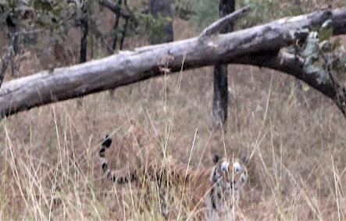

OPEN JEEP SAFARI @PENCH TIGER RESERVE

Slide 5
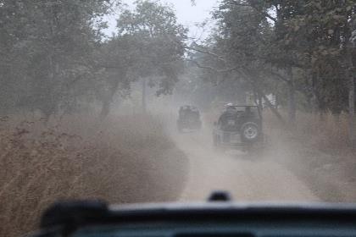
KEY LEARNINGS FROM MY TRIP TO PENCH
Forest officials now embrace Tech to enforce very strict entry/exit permits.
Villagers in the buffer zone play a vital role in conservation efforts.
Huge variety of species observed during the walking tour in the buffer zone.

Slide 6

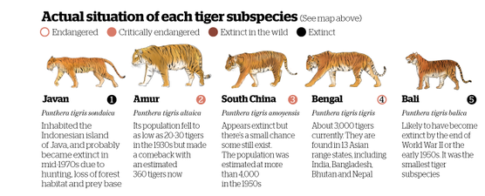
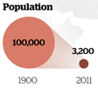
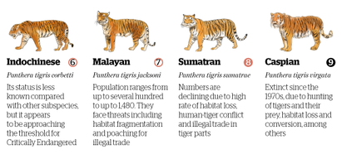
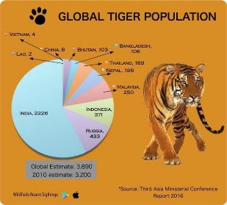
TIGER STATS
Home range 97% lost
3%
Notes:
Bengal tiger population around 40,000 tigers in 1947 (when India gained independence).
In the USA, there are no federal laws regulating the possession of exotic animals. You can buy a tiger online (a five-month-old tiger cub costs around US $14,000).
“There could be more than 10,000 tigers living in secret across America,” Business Insider, Jun. 2, 2016

Slide 7
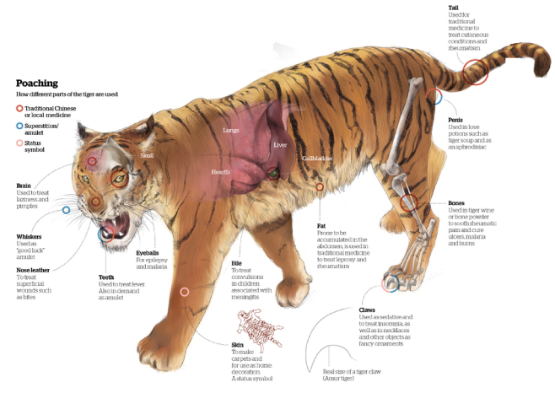

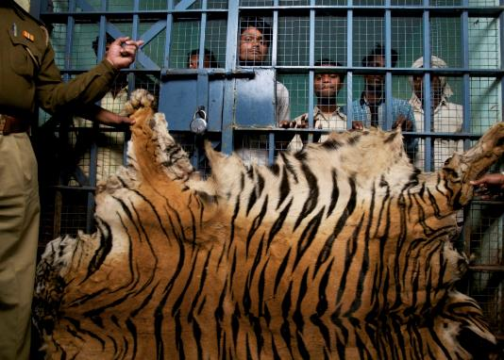
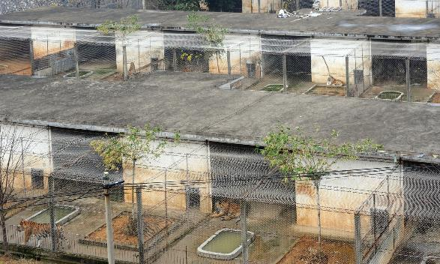
(IL)LEGAL WILDLIFE TRADE
Men arrested while trying to sell a tiger skin near Chandrapur, India
Brochure advertises wine made from tiger bone.
How different parts of the tiger are used
Xiongsen tiger farm in Guilin, China
“China allows use of tiger and rhino products, infuriating wildlife activists,” ecodaily.org, Oct. 30, 2018.
“As Asian Luxury Market Grows, A Surge in Tiger Killings in India”, Yale E360, January 10, 2017
Notes:
Tiger farms have proliferated in China in recent years, spurring demand for tiger hides, bones and other body parts.
$7B revenue

Slide 8
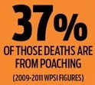
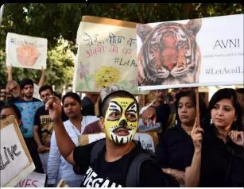
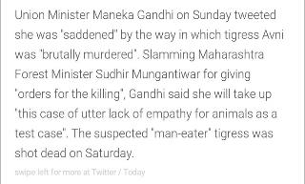
WHAT ARE THE BIGGEST THREATS?
  Hunting is the biggest threat in India (even in well protected areas).
  Extraction of forest products is currently unsustainable - logging, grazing.
  Accelerated development projects for mines, bio projects fragmenting the forest cover.

Slide 9
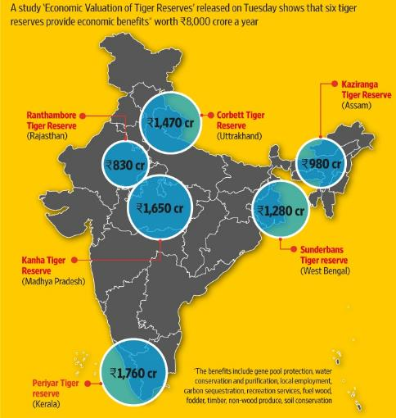
WHY IS CONSERVATION IMPORTANT?
  Tigers have their right to live regardless of what economic value they hold
  Apex predators keep the forests and the wildlife healthy
  Creates economic opportunities for local people in the ecotourism industry
  Highly significant symbols in Asian cultures
Notes:
Benefits of tiger reserves: carbon storage, nutrient cycling, pollination, recreation.
Many of the benefits are intangible and have no market

Slide 10

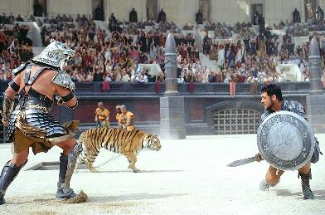

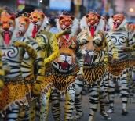




TIGERS HAVE INSPIRED GENERATIONS
“Tyger Tyger, burning bright,
In the forests of the night;
What immortal hand or eye,
Could frame thy fearful symmetry?,…”
–William Blake (1794)
Notes:
A tiger family depicted in a Korean scroll from the late 18th century

Slide 11
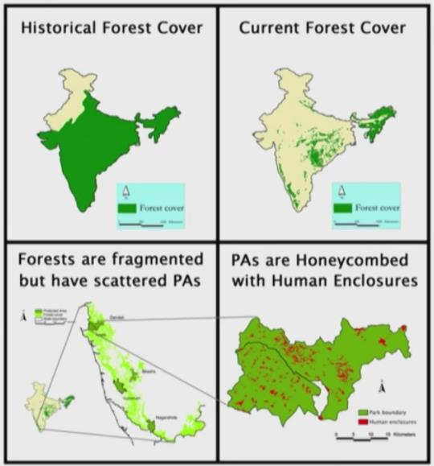

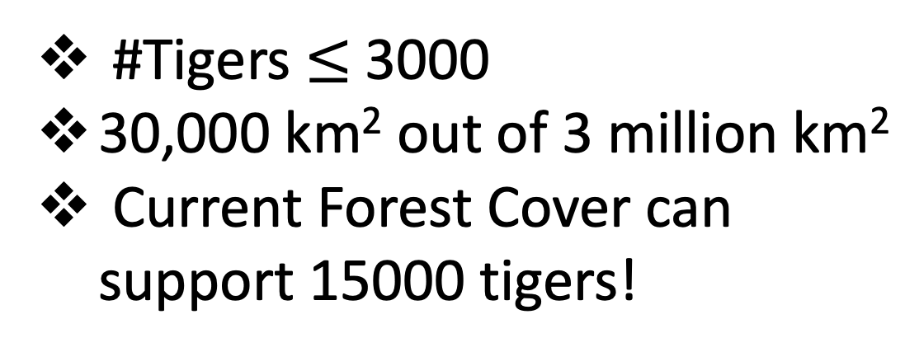
WILL CONSERVATION WORK?
#Tigers $≤$3000
30,000 km² out of 3 million km²
Current Forest Cover can support 15000 tigers!
Notes:
Tigers breed well when given enough protection

Slide 12
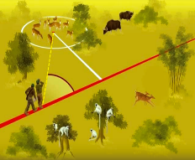
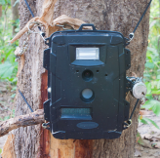
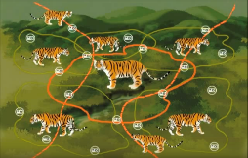
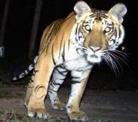
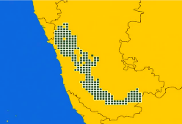
HOW DO YOU COUNT TIGER AND PREY POPULATIONS IN THE WILD?
  Line Transect sampling for estimating prey populations
  Capture-Recapture Sampling
    Camera Trapping
  Occupancy Sampling
    Paw prints
    Scats
A.
B.
C.

Slide 13
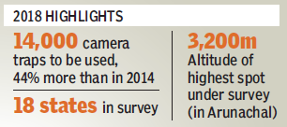
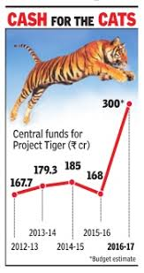
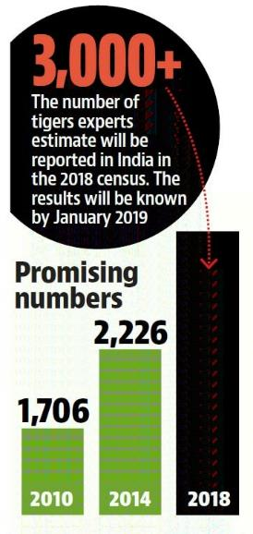
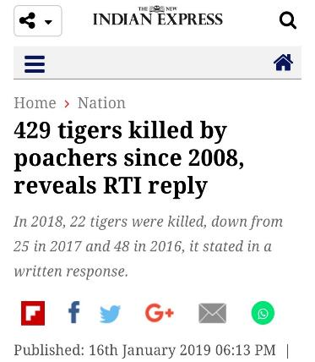
TIGER COUNT FROM 2018 CENSUS

Slide 14


MY STORY
MASTERS RESEARCH @ INDIAN INSTITUTE OF SCIENCE
WIRELESS SENSOR NETWORK FOR HUMAN INTRUSION DETECTION
Started out as a defense project funded by the DRDO & CAIR
I joined in the last 2 years of 3 year project
    Though many algorithms were developed and papers published, DRDO insisted we demo a real-world system
    Lots of sensing modalities were tried out
“Wireless sensor networks for protecting wildlife and humans,” project funded by NSF, USA, and Department of Electronics and Information Technology (DeitY), India, under the Pervasive Communications and Computing Collaboration (PC3) initiative.
“Sensor-based system to detect forest intruders”, The Times of India (Bangalore), Jun 9th 2015.
Notes:
Tiger Reserve @Panna National Park, Madhya Pradesh

Slide 15

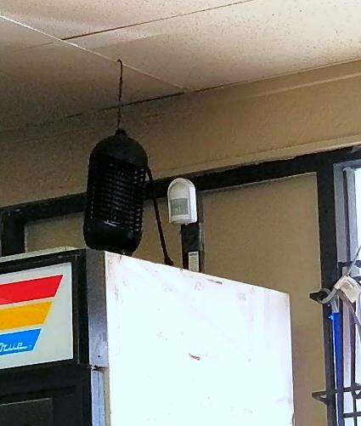

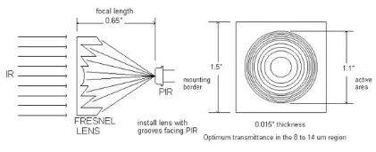
MOTION DETECTOR
FRESNEL LENS

Slide 16

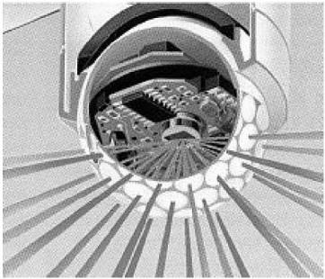

PASSIVE INFRARED SENSOR BASED SYSTEM
3 SENSOR PLATFORM
PANASONIC MOTION SENSOR AMN24111
GOLF BALL LENS
“Passive” implies low power, inexpensive, deterministic behavior, compact.
The sensor was largely a black-box and I worked out an analytical model for the same.
The golf ball lens reminds of the compound eye.

Slide 17
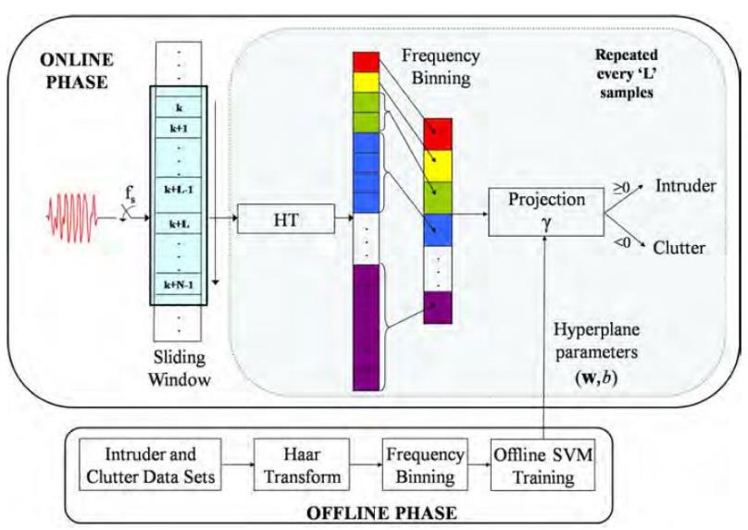


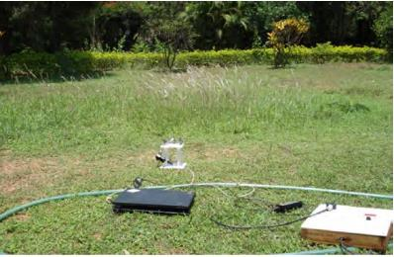
INTRUSION DETECTION ALGORITHM
SPRINTING INTRUDER DETECTED
FUNCTIONAL BLOCK DIAGRAM OF THE ALGORITHM
INTENSE CLUTTER REJECTED

Slide 18
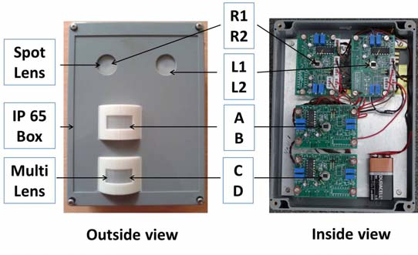
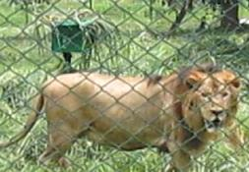


DEPLOYMENT IN BANNERGHATTA BIOLOGICAL PARK
My juniors, Tarun and Raviteja, led the effort to develop a sophisticated camera trap.
A small scale deployment inside the BBP for 2 days.
Learning experience as it brought out the need for better concealment and stronger ruggedization.

Slide 19

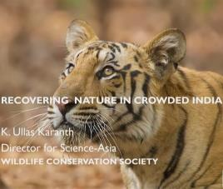
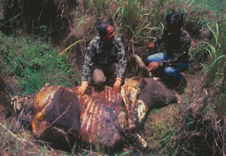
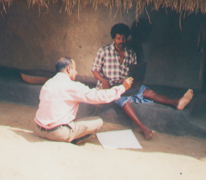
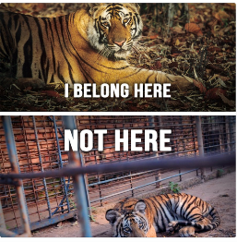
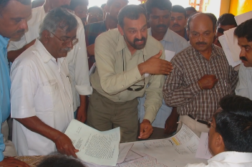

LISTENING TO CONSERVATIONISTS
Dr. K. Ullas Karanth
Conservation efforts must be guided by Science.
Conservation by one key species saves multiple species.
Earmark areas for urbanization, conservation, agriculture.
Notes:
https://youtu.be/DTLIq-p0EAY
https://cwsindia.org/k-ullas-karanths-remarkable-keynote-address/

Slide 20

HOW CAN I GET INVOLVED?
Visit National Parks, click and share pics on social media
  Pick your favorite tiger and ‘track’ it over the years
M-STrIPES mobile app to track, and geo-tag images.
Adopt a Tiger!
Make tiger consumption socially unacceptable.
  Support celebrity who support this cause, e.g. Jackie Chan, Richard Branson
Do visit the Guindy Snake Park & Madras Crocodile Bank Trust in Chennai
  Founded in 1972 by Padma Shri Romulus Whitaker
  Currently, he is coordinating efforts towards saving the Gharial, which is at the brink of extinction.
Commit to a cause that you like
  60% of wild coffee, king seals going extinct
Notes:
MSTrIPES - Monitoring System for Tigers - Intensive Protection and Ecological Status

